Slide 1

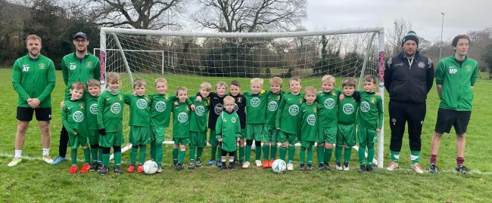
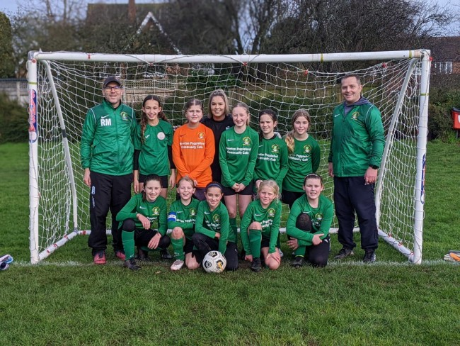

Player and parent welcome pack

Slide 2


Sidmouth Town Junior Vikings FC is an FA Charter Standard Club
Since starting in 1980 the club has continued to grow.
We have over 300 players with 5 girls’ teams (playing in the Devon Girls League)
and 20 mixed teams (playing in the Devon and Exeter youth league)
Our teams age groups range from U6 all the way to U16

Slide 3
Parents to do list ……..
Check with the appropriate age group coach for availability of places. U7 players, for example turn 7 between August 31st of current year and August 31st of the following year. For list of managers see: https://sidmouth-town-junior-vikings.co.uk/team-managers
(2) Create FAN number for one parent and your child at the FA website: https://account.thefa.com/createaccount
3) REGISTER with Sidmouth Town Junior Vikings and please pay subs at the same time. Our form is: https://sidmouth-town-junior-vikings.co.uk/membershipform
Registration and payment of subs are necessary for your child to be provided with a full team kit, to represent the club and be insured. If you require help please contact our club secretary, Ruth French.
(4) You will be added to your team’s WhatsApp group within a few weeks. If you have not been added after a few weeks, please contact the coach or in the unlikely event of a problem, the club chairperson, Brendon Willey.
(5) Please read the FA Respect Code of Conduct for players and parents: https://www.thefa.com/~/media/019A1BD1FDD040458A6F7A8E9C49D394.ashx
(6) ENJOY THE SEASON AND HAVE FUN!
?

Slide 4


Pitches
For Mixed Teams
U6/U7/u/u9 3v3 5V5 pitches are at Sidford recreation
U10-U13 7v7 and 9v9 pitches will be at back lane Newton Poppleford
U14 11v11 pitches are at Salcombe Regis recreation field (scout field)
U14-U16 pitches are at Sidford recreation behind rugby pitch
Girls Pitches
U7-U9 Sidford recreation Pitch
U10-U16 Newton Poppleford
Important Dates
Please note the season starts on the first week of September and ends the first week of May

Slide 5
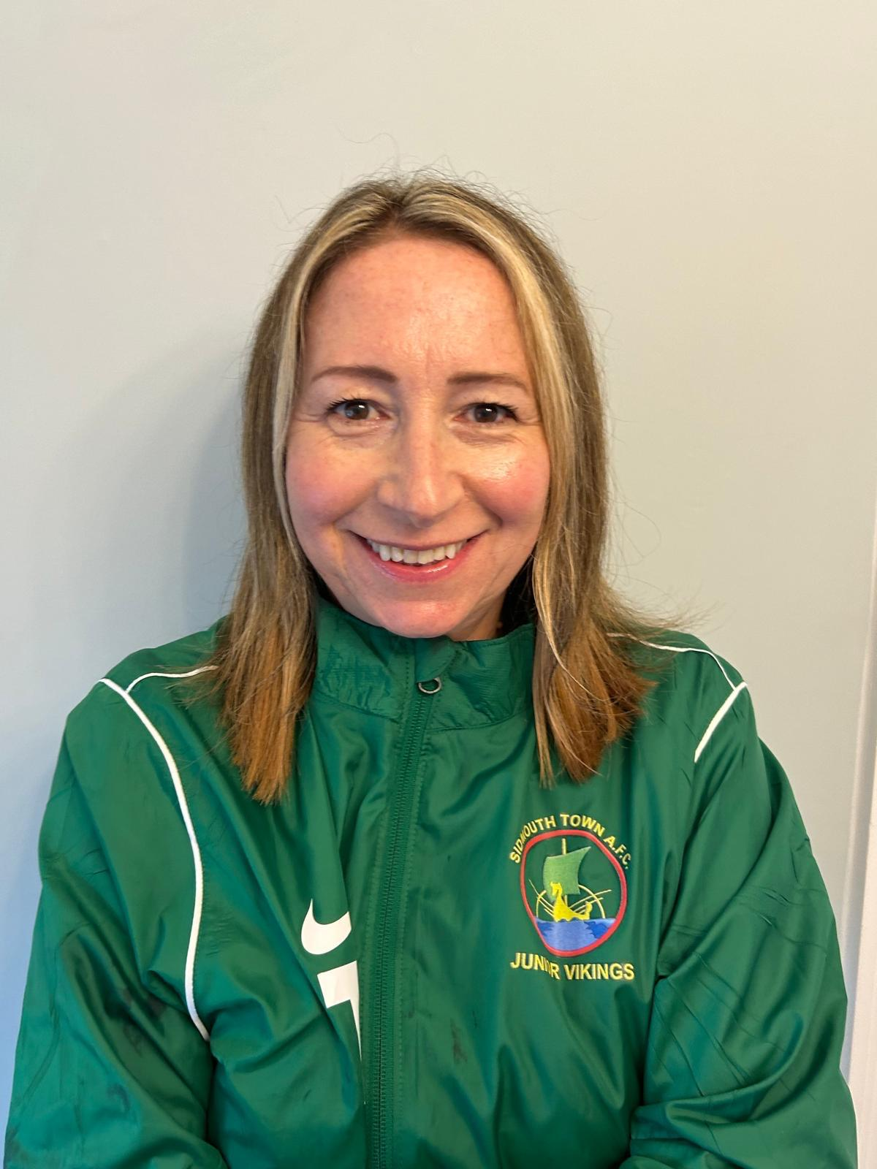
Cathy Payne
Club Welfare Officer
Hello, I look after the welfare of all the junior players during their time at Sidmouth Town Junior Vikings FC.
I work alongside the FA to ensure your child’s experience at Sidmouth is safe & positive. I make sure all Coaches & Assistants are recently DBS checked, recently safeguarding trained, & understand their role in terms of well-being.
I also handle any concerns regarding the wellbeing or safety of junior players.
You might see me from time to time at matches, training, or Club events. Please feel free to say hello, or contact me in confidence, if you have any questions or concerns regarding wellfare or safeguarding.
I recommend that all parents & carers of junior players take the free, short FA Safeguarding Awareness course for Parents & Carers, which gives you more detail on this, & will increase your awareness & confidence around safeguards within junior football.
The link is : https://learn.englandfootball.com/courses/safeguarding/safeguarding-awareness-for-parents-and-carers
My email is
Cathy.Payne600@gmail.com

Slide 6
Kit and Sponsorship
With this coming season being so successful already and with player numbers increasing each year . We have now grown our club to 21 mixed teams and have 6 girls’ teams .
Therefore, we now have a couple of sponsorship opportunities available.
We are looking for companies to sponsor our teams matchday kits.
If you or your business are able to help and support a team by providing a sponsorship, then please contact the club kit officer (Tammy Lines)
CLICK HERE TO JOIN OUR FACEBOOK PAGE

Slide 7
Have a great Season and welcome to Sidmouth Town Junior Vikings
Club Directory
https://sidmouth-town-junior-vikings.co.uk/committee
Click here to join our facebook page

