Slide 1

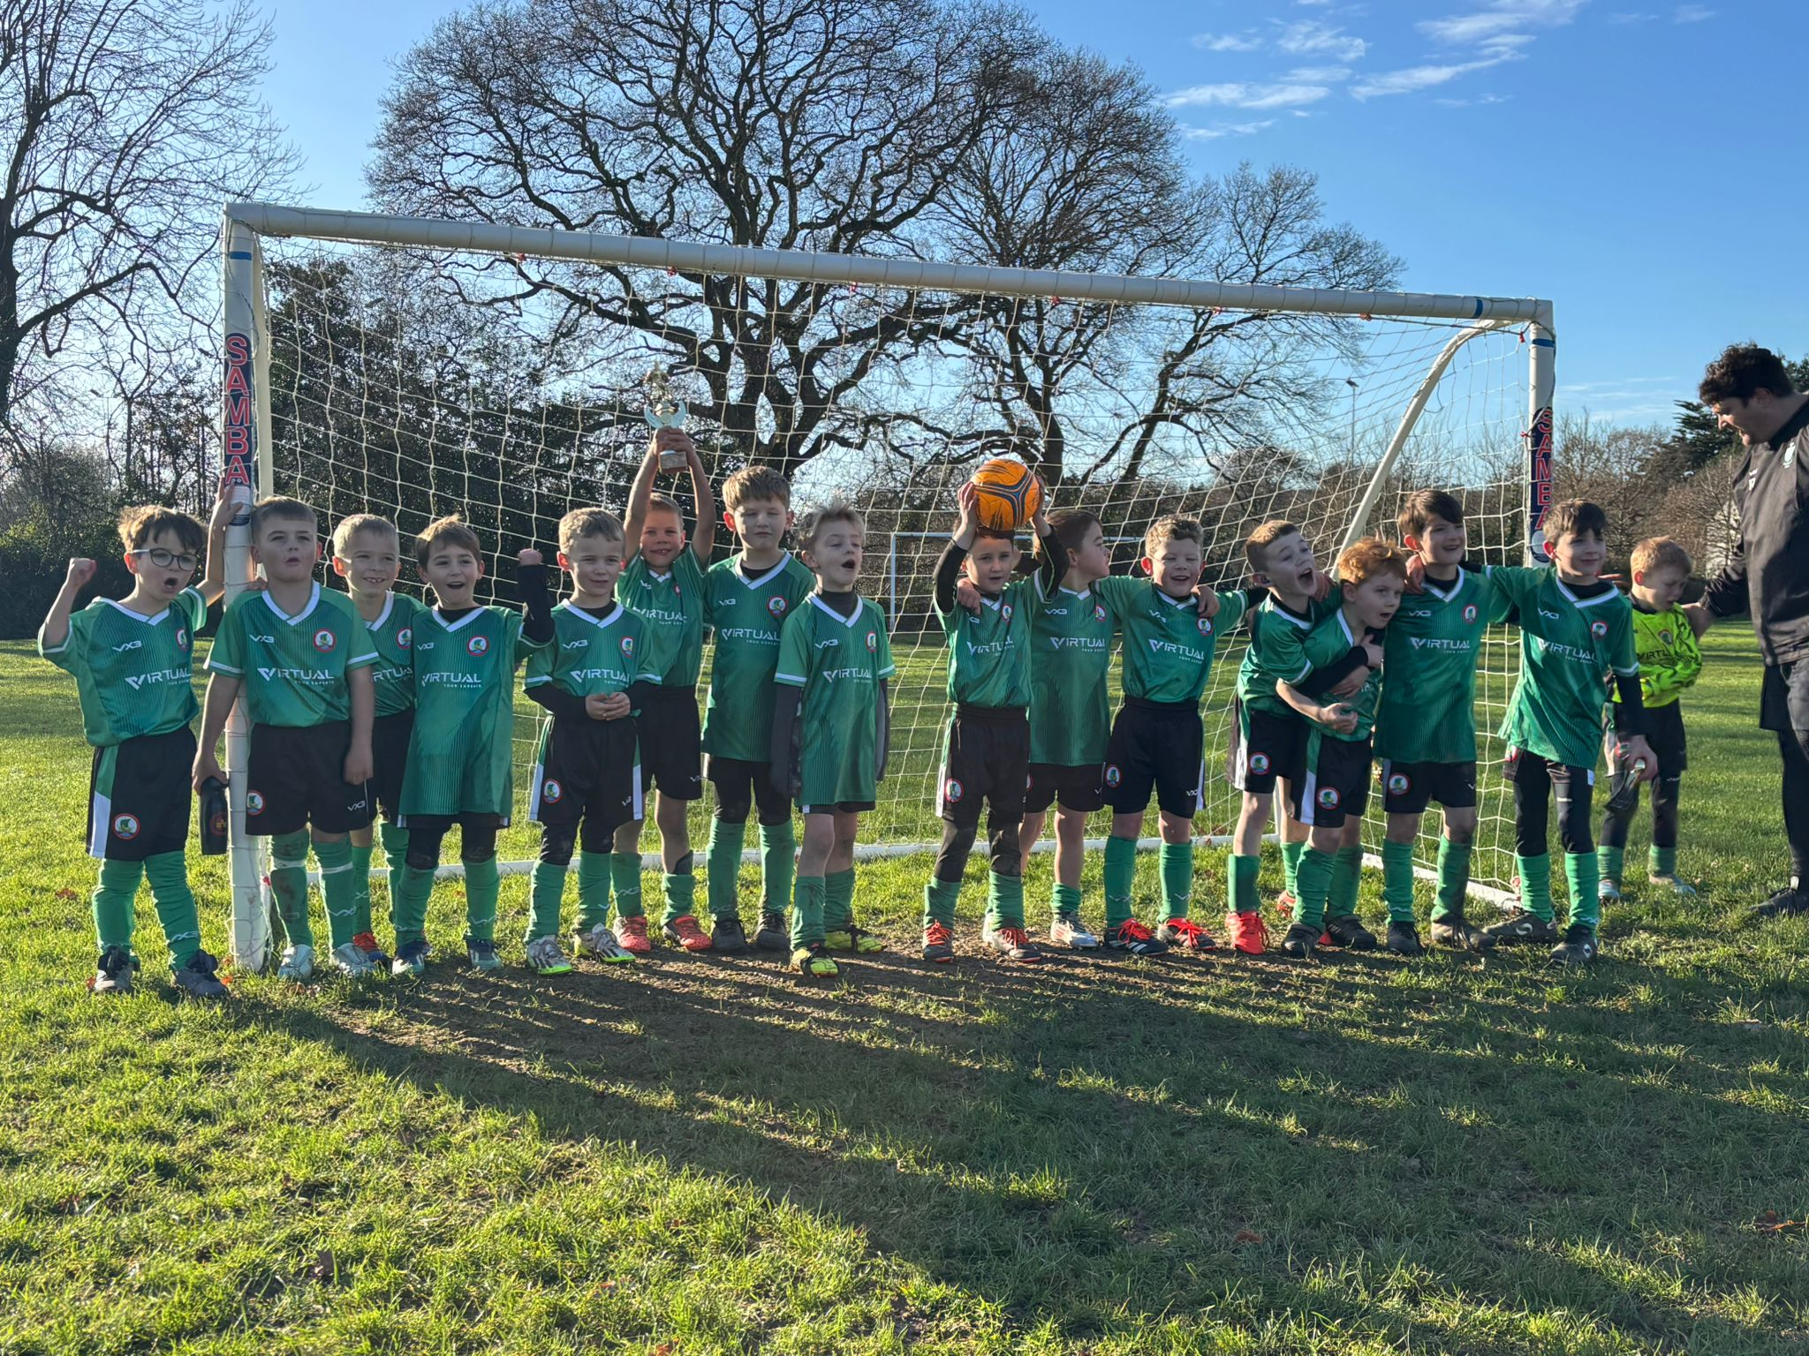
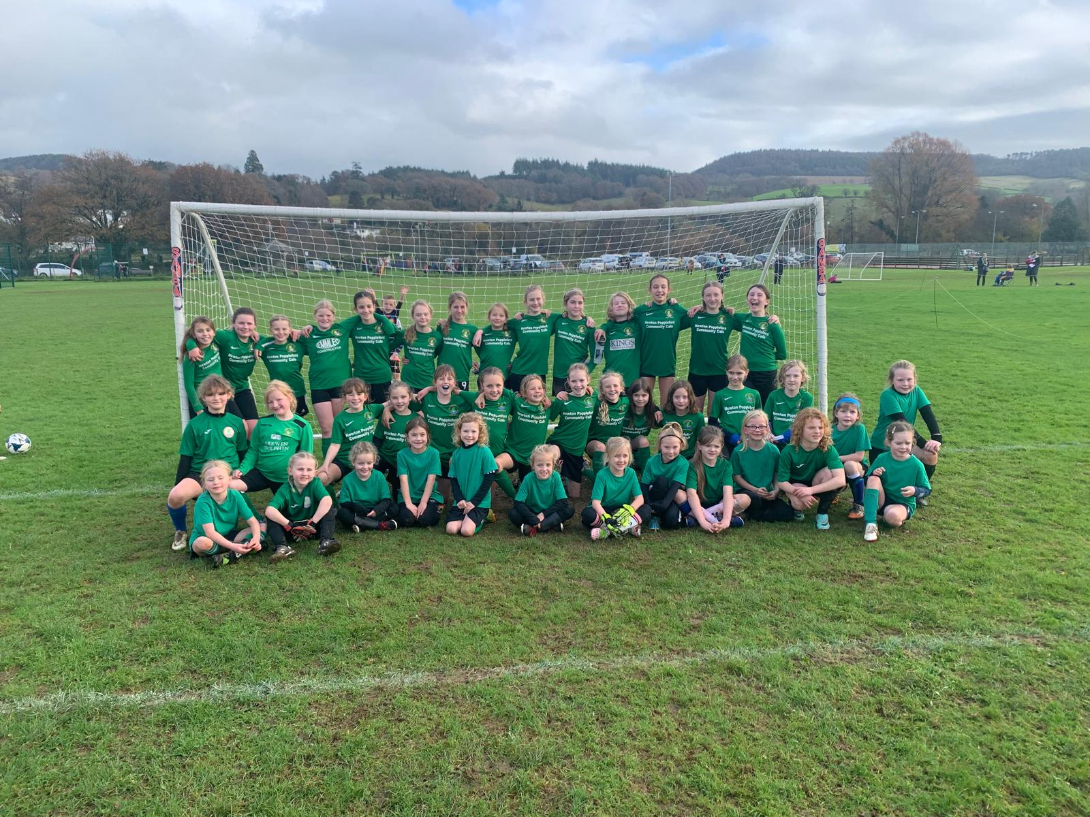
SIDMOUTH JUNIOR VIKINGS 2026 AGM
12TH JULY 6:00PM NEWTON POPPLEFORD

Slide 2
AGENDA
Welcome and Opening of Meeting
  Chairperson's welcome
Apologies for Absence
Approval of Previous AGM Minutes
  Review of minutes
  Matters arising
Chairperson's Annual Report
  Review of the past season
  Club achievements
  Challenges and future objectives
Secretary's Report
  Membership update
  Governance and administration
  Safeguarding and compliance
Treasurer's Financial Report
  Presentation of annual accounts
  Income and expenditure summary
  Budget for the forthcoming season
  Appointment of auditor/examiner
Football Reports
  Youth Teams Report
  Coaching Development Report
Facilities and Grounds Report
  Pitch maintenance
  Equipment update
Election of Club Officers
  Chairperson
  Vice Chairperson
  Secretary Boys
  Secretary Girls
  Safeguarding and Welfare
  Treasurer
  Football Development
  Fund Day officer
  Pitch Officers Sidford Sidbury Newton Popp Salcombe positions
  Social Media Officer
  Kit officers
  Funding and Sponsorship Officer
  End of season Trophies Officer
Membership Fees
  Review of current subscription fees
  Approval of fees for the coming season
Motions and Resolutions
  Consideration of motions submitted by members
Any Other Business (AOB)
  Questions from members
  General discussion
  Closing Remarks
  Chairperson's closing comments
  Meeting closed

Slide 3

CHAIRMANS OPENING REVIEW
Good evening everyone, and thank you all for attending our Annual General Meeting.
As another football season comes to a close, it gives us the opportunity to reflect on what has been another busy and rewarding year for our club. Grassroots football is about far more than results on a Saturday or Sunday morning. It is about providing a safe, enjoyable, and inclusive environment where players of all ages and abilities can develop their football skills, build confidence, make friends, and create lasting memories.
This season we have once again seen fantastic commitment from our players, coaches, managers, volunteers, parents, and supporters. Every training session, every match, every fundraiser, and every hour spent behind the scenes has contributed to making our club what it is today.
I would like to congratulate all of our teams on their efforts throughout the season. Some have celebrated league titles, promotions, cup runs, or personal achievements, while others have faced challenges and setbacks. Regardless of results, every player who has worn our badge has represented the club with pride, determination, and respect.
Our coaches and team managers deserve enormous recognition. They give countless hours each week planning sessions, organising fixtures, supporting players, and creating positive learning environments. Their commitment is the backbone of our football programme.
Equally, I would like to thank our volunteers and committee members. Running a grassroots football club involves far more than football itself. There is safeguarding, finance, registrations, facilities, fundraising, social media, kit management, sponsorship, and countless other responsibilities. Much of this work goes unnoticed, yet it is essential to the smooth running of the club. Thank you for everything you do.

Slide 4
CHAIRMANS OPENING REVIEW
To our parents and families, thank you for your continued support throughout the season. Early morning starts, long journeys, volunteering on matchdays, and encouraging every player from the sidelines all help create the positive atmosphere that makes our club so special.
I would also like to express our sincere appreciation to our sponsors and local community partners. Your generosity enables us to provide equipment, maintain facilities, keep football affordable, and continue investing in opportunities for our players.
While we should celebrate our successes, we also recognise there is always room to improve. As a committee, we remain committed to developing our facilities, supporting coach education, strengthening safeguarding, increasing participation, and ensuring that every player feels welcome and valued regardless of ability or background.
Looking ahead to next season, we have exciting opportunities to continue growing the club with longer leases, more funding and hopefully a home for the future. We hope to welcome new players, recruit additional volunteers, strengthen our community partnerships, and continue providing the best possible football experience for everyone involved.
Finally, I would like to thank every single person who has contributed to our club this season. Whether you gave hundreds of hours or simply cheered from the touchline, you have played an important part in our success.
Grassroots football is built on teamwork, dedication, and community spirit. Together, we continue to create opportunities for young people to enjoy the game we all love.
On behalf of the committee, thank you for your support throughout the season. We wish everyone a safe and enjoyable summer and look forward to seeing you all again next season.
Thank you.
Brendon W

Slide 5
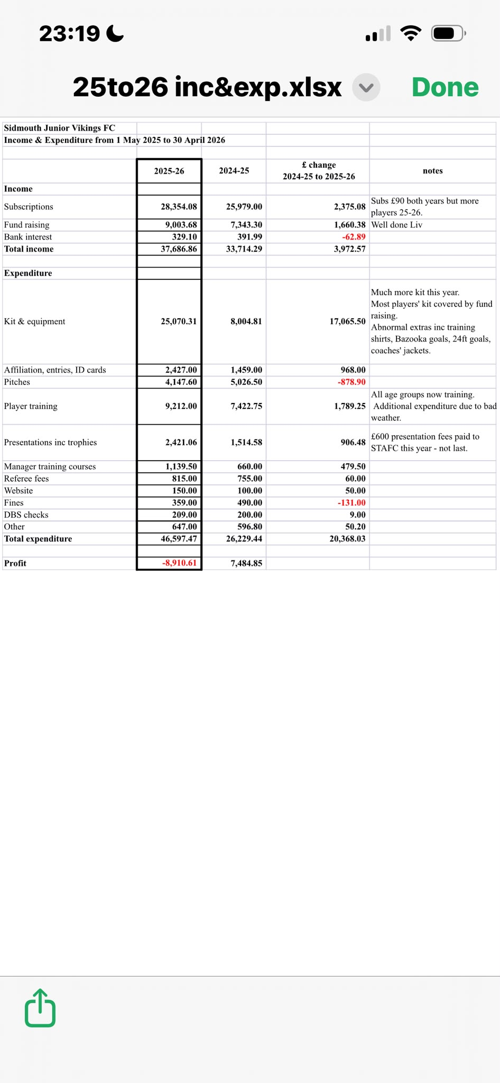
TREASURER REPORT
Treasurer’s report for AGM 12 July 2026 The 2025-26 accounts have been audited by Amy Churchill and were passed. The headline is that a loss of £8,910 was made.
We started that year with £20,418 in the bank and finished with £11,507.
Despite the loss we remain in a healthy financial state, but clearly a rise in subs fees is required in 2026-27.
The table shows income and expenditure for the year in various categories. Also added are the figures for 2024-25.* Subscriptions rose by £2,375 due to an increased number of players. Subs fees were unaltered.* Kit and Equipment rose by £17,065 due to 24ft goals, training shirts, bazooka goals and more player kit, but much of latter was funded by sponsors.* Player training rose by £1,789. All age groups are now training. Some additional expenditure was due to waterlogged pitches.* Presentation costs rose by £906. £600 was paid to STAFC in 2025-26 but not in 2024-25.* Other in 2025-26 included Newton Poppleford skip hire £510.

Slide 6
CHAIRMAN REPORT
Chairperson's Annual Report
BUILDING AND FIELD AT SIDBURY UTD OLD GROUND MAKING STEADY PROGRESS
SECURING A 30 YEAR LONG TERM LEASE, ALLOWING THE CLUB EXCESS FOR MORE ADDITIONAL FUNDING
WE HAVE SPENT A LOT OF MONEY THIS SEASON AND INVESTED IN A LOT OF KIT AND EQUIPMENT (TRAINING JERSEYS , COACHES KIT.
IMPLEMENTED 1 COACH IN EACH TEAM HAS A MINUMUM LEVEL 1 QUALIFICATION WHICH THE CLUB PAYS FOR
SECURED LONG TERM CONTRACTS 15 YEARS AT NEWTON POPPLEFORD FOR CONTINUE GROWTH AND EXCESS TO ADDITIONAL FUNDING.
START OF PROGRESSION CENTRES WHICH HAS BEEN A GREAT SUCCESS
START OF GOALKEEPING CLINICS WHICH HAVE BEEN A GREAT SUCCESS
START OF SUMMER FOOTBALL CAMPS IN PARTNERSHIP WITH STJV
26 TEAMS GOING INTO 2026/27 SEASON
DEVON FA CPD AND TRAINING EVENTS WERE A GREAT SUCCESS
INDUCTION DAY REVEMP WITH PARENT MEETINGS AND SESSIONS WITH OUR GREAT COACHES
80 COACHES IN THE PROGRAM
ADDITIONAL COMMITTEE MEMBERS (WE STILL NEED MORE)
WINTER TRAINING VENUES ALL SET AND BOOKED
  Club achievements
  EXTRA STAR ACCREDITIONA (WE ARE NOW A 2 STAR CLUB) PREVOUISLY ONE STAR
  U13 GIRLS WON THE LEAGUE
  HAVE A GIRLS TEAM AT EVEY AGE GROUP
  MORE SOCIAL MEDIA EXPOSURE INSURING CLARITY AND TRANSPARANCY WITH ALL ITS MEMBERS

Slide 7
Social Media Report
Social Media Officer's Report
I took on the role of Social Media Officer in February, and since then my focus has been on establishing Facebook as a key communication and promotion tool for the club. My aim has been to celebrate our players, support our coaches and volunteers, recognise our sponsors, and keep members and the wider community up to date with everything happening at STJV.
Since February, we've shared match reports, tournament successes, player achievements, club news, fundraising events and recruitment opportunities. We've also introduced a more consistent style of branding to create a recognisable STJV identity, along with video reels and our 'Team of the Week' posts celebrating Players of the Match across the club.
I'm pleased to say our followers and post reach have continued to grow, helping us showcase the club to an even wider audience.
Supporting our sponsors has remained a priority. Every sponsor has been recognised on our Facebook page and linked to the team they support, with match reports regularly tagging sponsors to provide ongoing recognition throughout the season.
I'd like to thank everyone who has sent in photos, videos and updates throughout the year. Your contributions have helped us showcase the club at its very best.
Looking ahead, I'd like to explore launching an Instagram account alongside Facebook to further increase our reach. I also hope we can encourage more coaches to share photos each week, as this has the biggest impact on engagement, helps us celebrate our players and gives our sponsors valuable visibility.
Finally, thank you to everyone who has liked, shared, commented on and supported our Facebook page this season. Every interaction helps raise the profile of STJV and highlights what a fantastic community football club we are.

Slide 8
SECRETARIES REPORT
This season the club has had a total of 352 registered players, made up of 14 mixed teams and 5 girls' teams.Player registrations have been completed throughout the season, including new registrations and transfers.
Thank you to all our team managers for providing the information required to ensure these were processed efficiently.Our girls' teams have continued to compete in the Devon Girls Football League, which continues to grow and is now part of the Future Fit programme, supporting the changes being introduced within youth football. Our mixed teams have once again competed in the Exeter and District Youth League.
The club remains part of the England Football Accredited Club Programme, continuing to demonstrate our commitment to providing a safe, enjoyable and well-run environment for all players.We are also pleased to confirm that all girls' and mixed teams have been successfully affiliated and registered for the 2026/27 season, with 26 teams now approved by Devon FA.Final league positions for the 25/26 season were as follows (competitive age groups only):U15s - 9th in Division 1U14s W - 6th in Division 2U14s R - 4th in Division 4U13s W - 7th in Division 4U13s R - 8th in Division 3U12s W - 11th in Division 2U12s R - 4th in Division 3U15s Girls - 8th in Division 2Congratulations to our U13 Girls, who were crowned Division 3 Champions this season.
A fantastic achievement by Trevor, the management team and all of the players. Well done to everyone involved.Finally, Glen and Ruth would like to thank all of our coaches, volunteers, team managers and committee members for their continued hard work and commitment throughout the season. Your dedication is greatly appreciated and is fundamental to the continued success of the club.
Glen & RuthClub Secretaries

Slide 9
Pitch Officers Report
Newton poppleford report
It was a good season overall we did lose five weeks due to flooding the pitches will be marked out for the new season late August. We have secured a 15-year lease which is great news for both mixed teams and girls teams hoping to have the pavilion on both days. All I’ll be asking this year is more people getting involved marking their Lines. Thanks
Salcombe Nothing to report all is well . Going to touch base with Mark roden regarding contract.
Sidford Nothing to report , good relationship with the council.
Ex Sidbury Utd
Field Officer Report:-Pitches held up well in 2nd half of season. Storage shed & goalpost location needs attention as in a mess.Progressing urgent dialogue with Council re a revised long-term lease on pitches, parking & old Changing Rooms. This could be BIG for the JV and could also cover storage concerns going fwd.See actions for more details.

Slide 10
Safeguarding and Welfare
81 Club Officials to date
All Coaches with DBS & safeguarding in date,
1 x First Aider per team
All Committee Members have DBS & Safeguarding for Committee Members
End of 25/26 Season Audit of teams shows:
3 Coaches have stepped down:
Ross Moughton U15R
Glenn Channing U9
Georgie Lamprill U12G
⁃ New Officials: Robbie Powell GK Sammie Smith CWO * Sam Roberts U6 Bev Hackett U7G* Sam Dawes U8R* Rachael Hailstone U8G Istvan Panko U8G* Nick Sayles U12G
Awaiting DBSAOB - Pleased to confirm we have Jay’s Aim coming to our new season Coaches Meeting in September to deliver training specifically on recognising and responding to signs of Cardiac Arrest in young people. To include CPR & DeFib training on the pitch. https://www.jaysaim.co.uk/cpr-defibrillitor-training

Slide 11
Sponsorship and Funding
We have secured sponsorship and ordered all kits for the new season - some kits already delivered. This was simpler than last year due to less teams requiring sponsorship and 3 of us, Tammy, Sarah and myself working on coordinating the kits. Spreadsheet shared with the 3 of us and Graham and Brendon had been incredibly helpful. Sponsorship was also simpler to secure as some rolled over and others already lined up by the coaches. I will look at starting much earlier with sponsorships for 27/29 seasons, probably this side of Christmas to allow time to secure for the larger number of teams. Also applying for Lionesses Her funding for the girls teams as it’s money to be accessed towards supporting girls football specifically.
Working on securing funding through the FF for grass pitch maintenance / storage containers / 3v3 goals and new goals for Sidford pitch. The goal application has to be done in one go so awaiting quotes for the 11v11 goals. Everyhting through FF requires an in put by us of 25% of any costs. We need to secure the pitch officially so that we can do a fund-raising evening to accrue some of these costs at the very least. Grass pitch maintenance fund is a 6 year commitment so need to discuss reality of accepting commitments to those costs or if there are beneficiaries that could come forward. Looking into funding for the whole project too that would be an alternative.

Slide 12
Election of committee Members
Chairman Brendon Willey
Vice Chairman Anthony Griffiths
Treasurer Greame Beech
Secretary Boys Glen Burnett
Secretary Girls Ruth French
Kit Officer Assistant POSITION OPEN
Kit Officer Sarah Shepard
Safeguarding and Welfare Officer Cathy Payne
Pitch Officer Sidford council pitches Anthony Griffiths
Pitch Officer Sidford (sidbury pitch) Richard Seldon
Pitch Officer Salcombe regis Glen Burnett
Pitch Officer Newton Pop Chris Davis
Football Development Brendon Willey
Sponsorship and Funding Officer Olivia Ethrington
Social Media and Website Officer Georgia Trengrove
Trophies and Presentations Craig Fitzhenry
Winter Training officer Chris Davis /Brendon Willey
Post 16 Liaison Officer Anthony Griffiths
Fun day committee Georgia Trengrove /Ruth French/Cathy Payne/ Sarah Shepard

