Slide 1

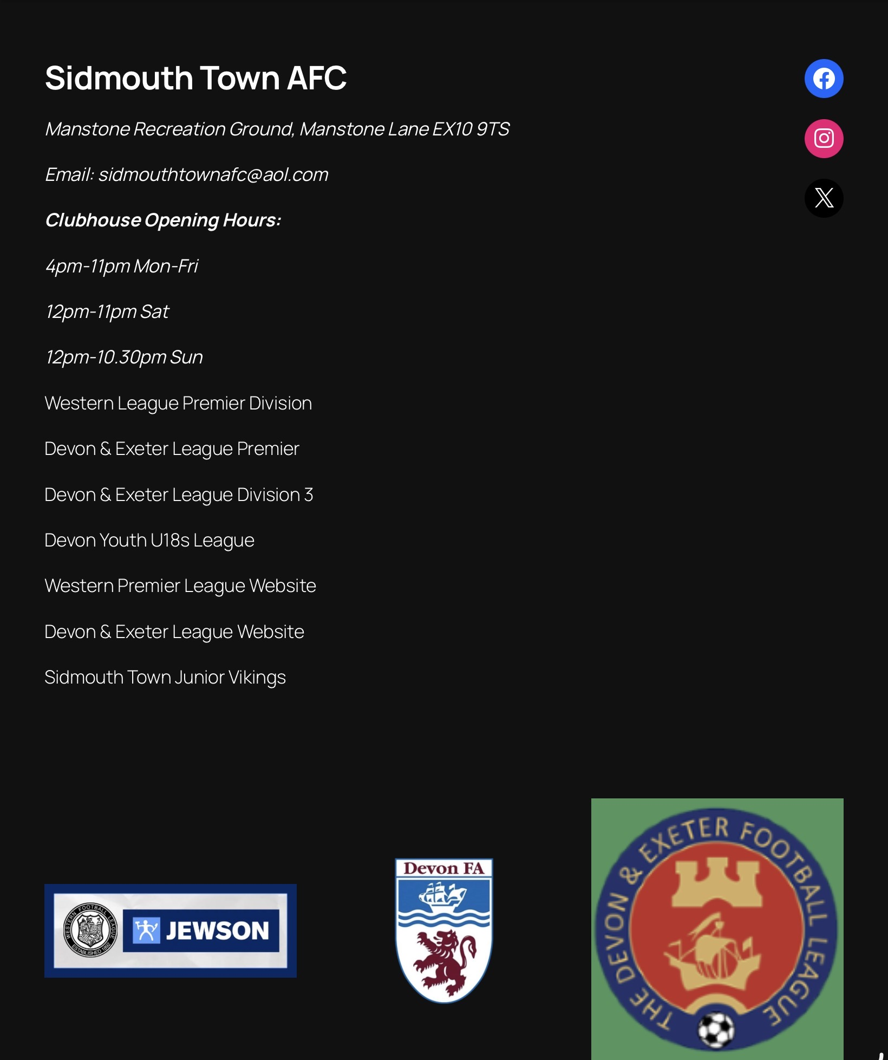
WHO ARE
WE
From Junior Football to Senior Football A Complete Football Pathway
Founded in 1895, developing players from youth to senior football
VETS → Junior Teams → Youth Teams → U18s → 3rds → 2nds → 1sts
From Junior Football to Senior Football A Complete Football Pathway

Slide 2
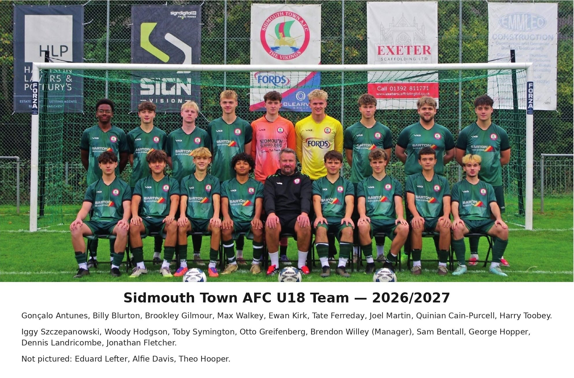
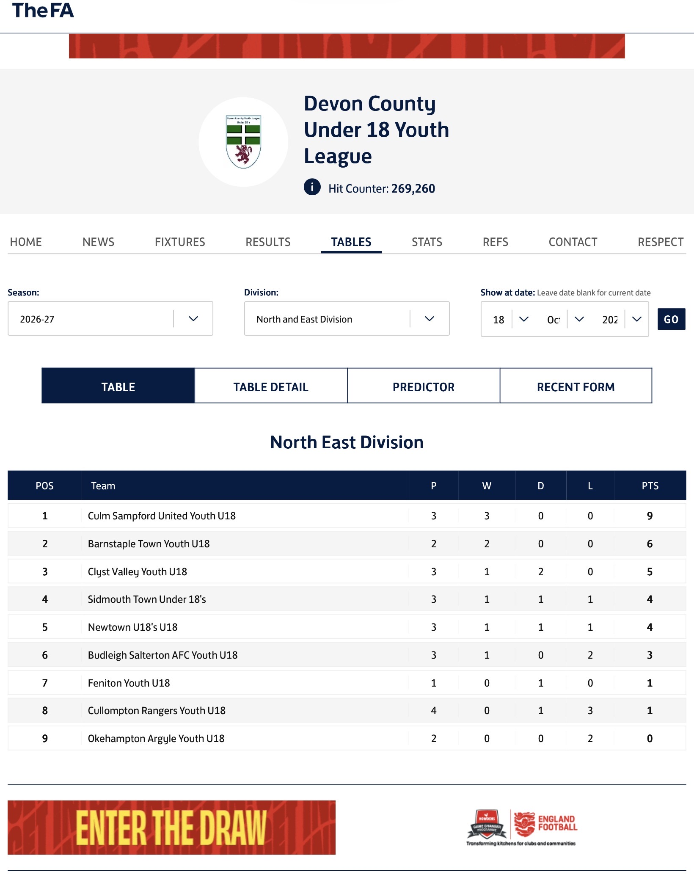
Under-18 Football
THE BRIDGE BETWEEN YOUTH AND JUNIOR FOOTBALL
For those wanting to attend training at u16 you are more than welcome training is Cranbrook educational campus ex57ee
Matches are on Sundays normally 2:00pm Kick off
Coach Is Brendon willey a professional coach with saints southwest , worked for arsenal soccer schools , Southampton , Major League Soccer Camps and training. Currently Chairman of Sidmouth Junior Vikings.
If you require more information please contact U18 Manager Brendon Willey Brenwsidmouthjuniorvikings@gmail.com
07496462616
Coaching opportunities … There is lots of coaching opportunities with sidmouth Junior Vikings . Why not start your coaching career with us get in touch with the above email and contact
Referee opportunities , want to take up refereeing get in touch with the above email.

Slide 3
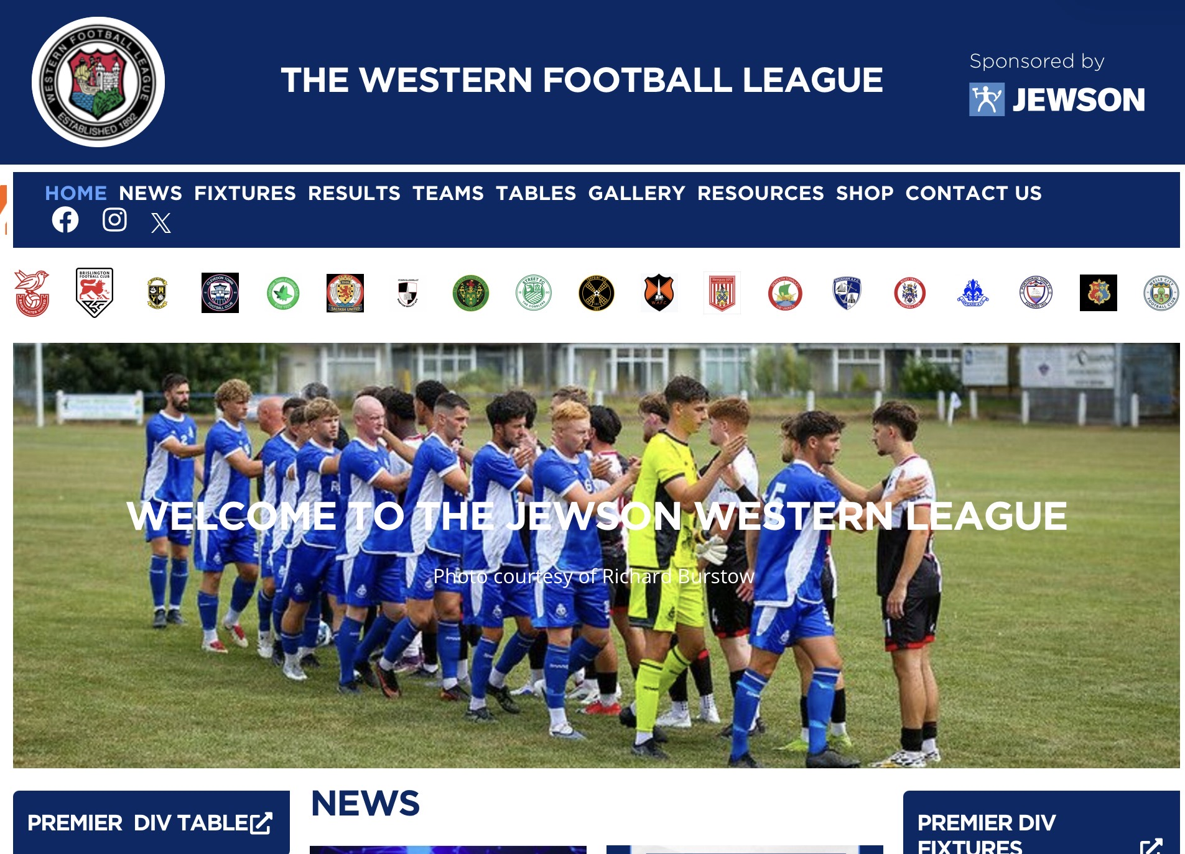



Men’s Football Structure
1st Team: Western League Premier
2nd Team: Devon & Exeter Premier
3rd Team: Devon & Exeter Division 3

Slide 4
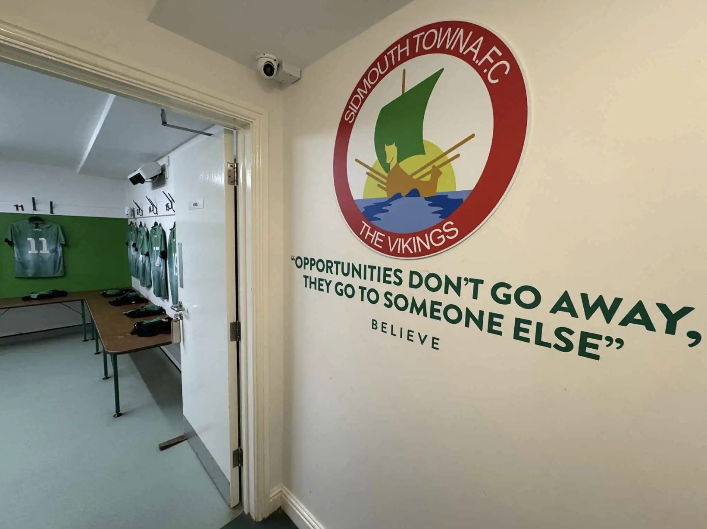
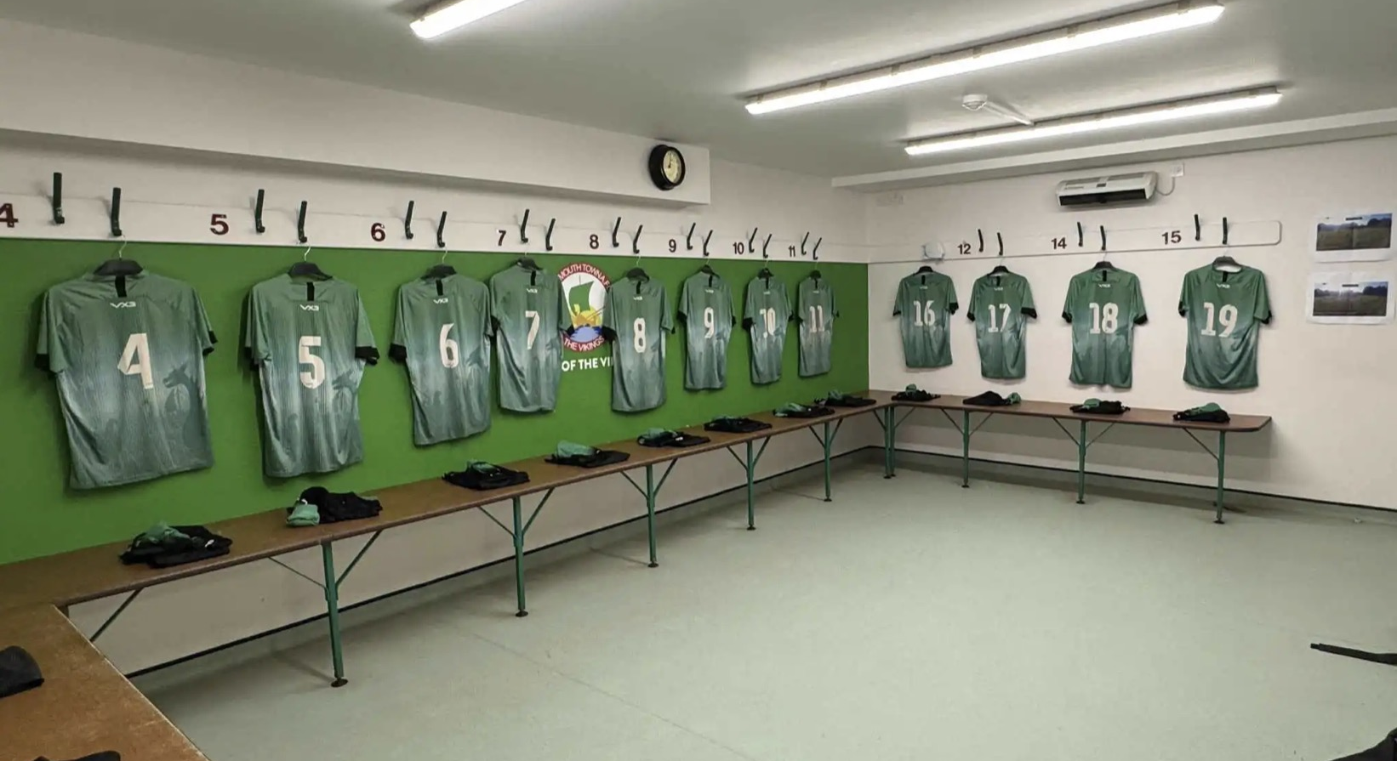
First Team
Competing in the Western League Premier Division.
Billy Rouse first team manager in close contact with all managers to see who can come up and train.
No age barrier very much if you good enough you are old enough

Slide 5
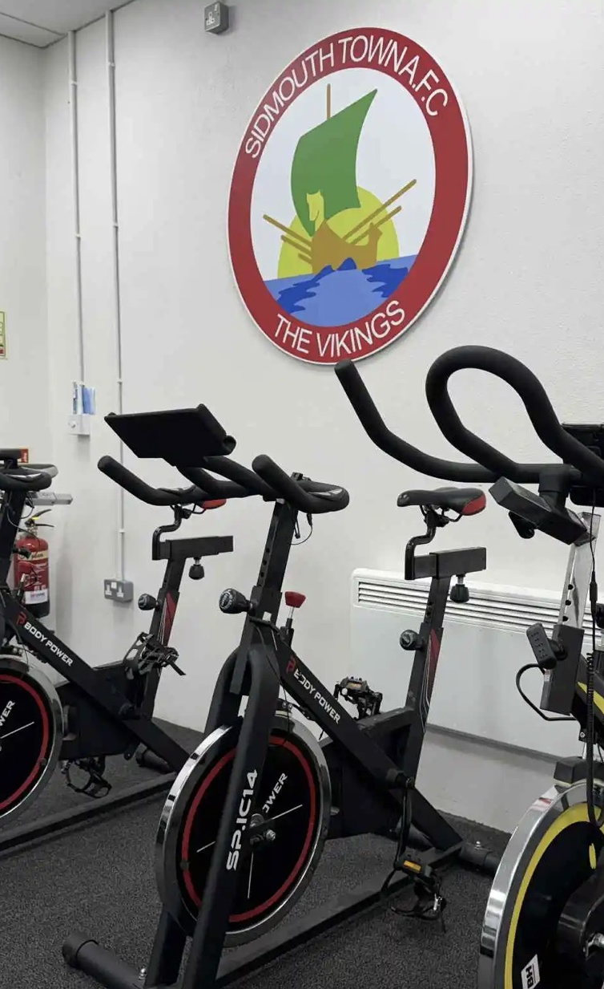
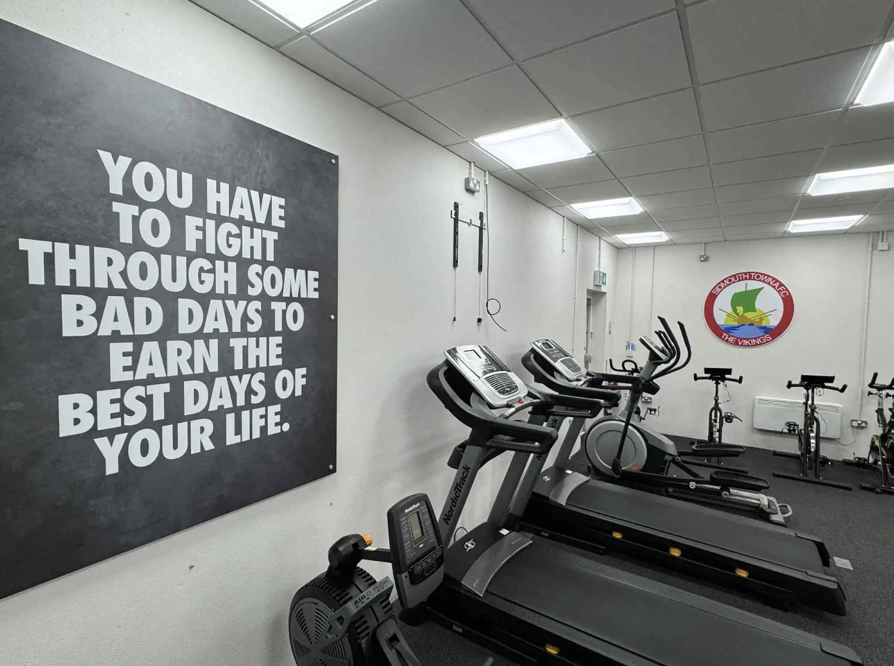
Why the Pathway Matters
Progression, opportunity and retention of local talent.

Slide 6
Helpful Webpages
One Club. One Pathway. One Community.
https://www.westernleague.co.uk/teams/premier-division/sidmouth-town
https://defleague.co.uk/
Plymouth Argyle Post 16 program
mailto:https://argylecommunitytrust.co.uk/what-we-do/post-16-football-programme/
Exeter City Post 16 program
mailto:https://exe-coll.ac.uk/course/sport-cefa-academy/
https://fulltime.thefa.com
https://sidmouth-town-junior-vikings.co.uk/
Www.sidmouthtown.co.uk

